Slide 1
DCYF’s Role in Child Care Statewide
Washington State Women’s Commission
January 31, 2019
Ross Hunter, Secretary, Department of Children, Youth, and Families
Vickie Ybarra, Director, Office of Innovation, Alignment, and Accountability

Slide 2
DCYF’s Three Primary Roles
Outcome goals for children, youth, and families
Kindergarten readiness
Children supported by healthy relationships with adults
Parents/caregivers supported to meet the needs of their children
Child development
Family economic security
Early Achievers
Quality
Licensing
Health & Safety
Child Care Subsidy Programs
Access to care

Slide 3
Child Care Subsidy Programs
Working Connections Child Care (WCCC)
Primarily serves families with income under 185% of the federal poverty level (FPL)
Parents who are working or are participating in a DSHS-approved activity at the time of application
Children experiencing homelessness or other traumas
Seasonal Child Care (SCC)
Families seasonally employed in agriculture
Not receiving TANF benefits, limited to ten specific counties
80,955 total children served by CCSP in FY 2018
38,508 of those children are under 5 years old and served in licensed care

Slide 4
Child Care Licensing & License Exempt Services
Child Care Licensing: Support early learning programs so that children in licensed care are in safe, healthy, and nurturing environments
License Exempt Services (FFN): Support Family, Friend and Neighbor (FFN) providers so that children in their care are in safe, healthy, and nurturing environments

Slide 5
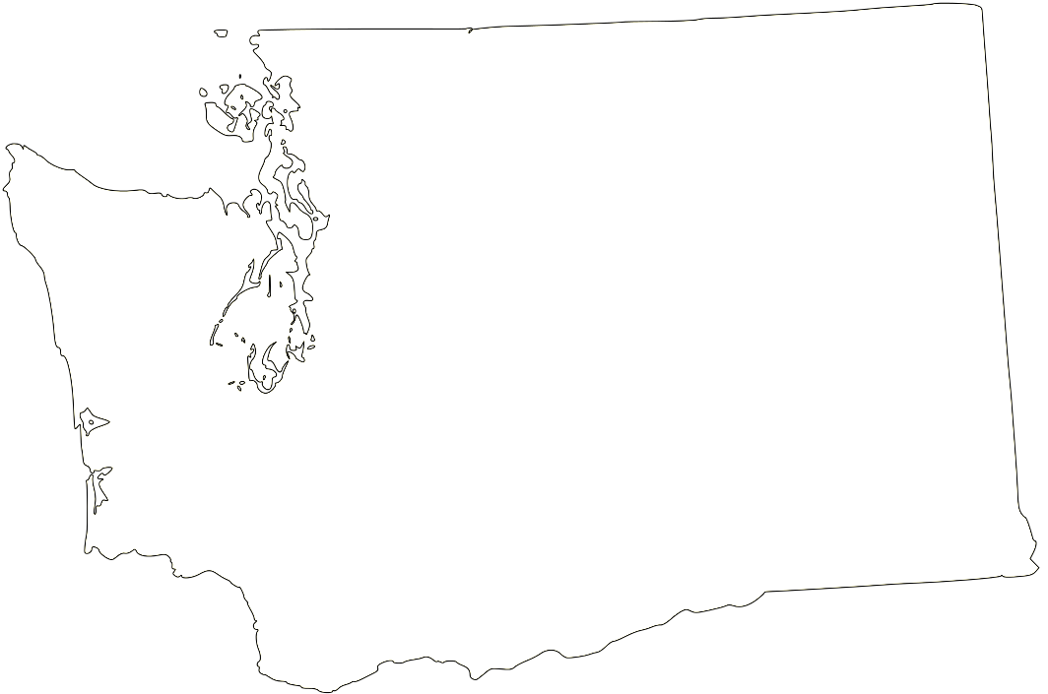
Child Care Licensing & License Exempt Services
Children in child care
Average capacity for licensed centers is 69 children*
Average capacity for a licensed family child care home is 10 children*
91% of centers and 79% of family child care homes accept subsidy^
FFN license-exempt 100% of families received subsidy assistance
Licensed child care early learning programs*
2,316 centers and school-age programs
3,300 family home child care programs
Family, Friend and Neighbor Providers
4,039 FFN providers*
* Source: WA Compass 8/12/19
^ Source: 2018 Child Care Market Rate Survey Report
Data taken from WA Compass 8/12/19
^ Data taken from the 2018 Child Care Market Rate Survey Report

Slide 6
Early Achievers
Washington State’s quality rating improvement system
Early Start Act 2015
Required participation for all providers serving state subsidized care to children aged <5
Voluntary for other licensed providers
Includes additional reimbursements, scholarships, and coaching for providers
Based on national research that shows children benefit from higher quality care, especially children from low income households
Notes:
Washington’s Quality Rating and Improvement System
Washington started developing as a voluntary program 2011

Slide 7
Early Achievers Participating Providers
Early learning providers, including:
Child care centers
Family child care homes
ECEAP/Head Start providers
Source: Early Achievers Dashboard, https://www.dcyf.wa.gov/sites/default/files/pdf/ea/EA-Dashboard.pdf

Slide 8
Extreme Child Care Access Deserts, 2019
Notes:
DCYF/OIAA has identified Extreme Childcare Access Deserts in Washington for 2019.
We’ve applied a method developed in Massachusetts by Dr. Erin Hardy at Brandeis, published in the 2018 report.
This method goes beyond the Center for American Progress method to identify those areas where access deserts are more extreme, which would allow a focus of resources.
The map here demonstrates Extreme Access Deserts (by zip code) for children <5 in Washington.

Slide 9
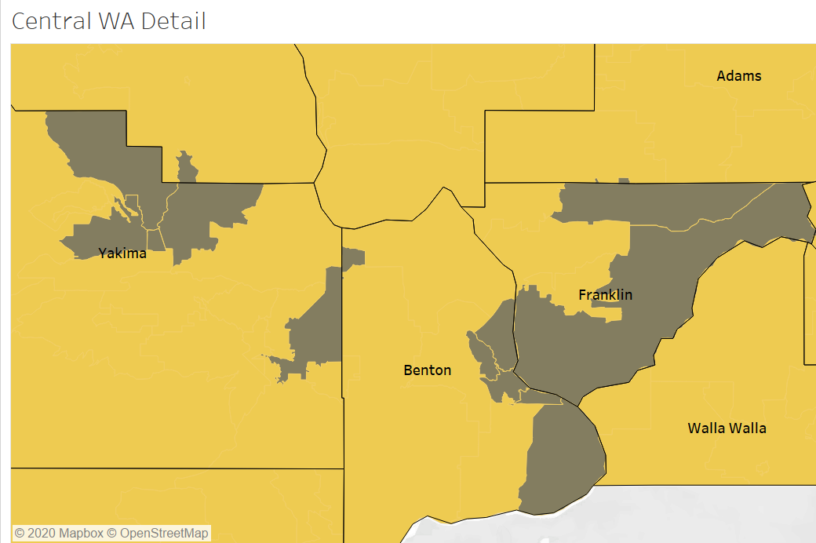
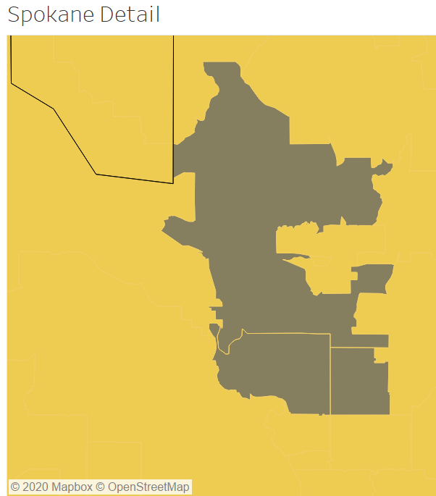
Extreme Child Care Access Deserts, 2019
Notes:
As might be expected, the shortages for child care are most extreme in the urban areas, where there are more children in need of care.
This slide zooms in on the same Extreme Child Care Access Desert zip codes in the Puget sound region, central Washington, and Spokane.

Slide 10
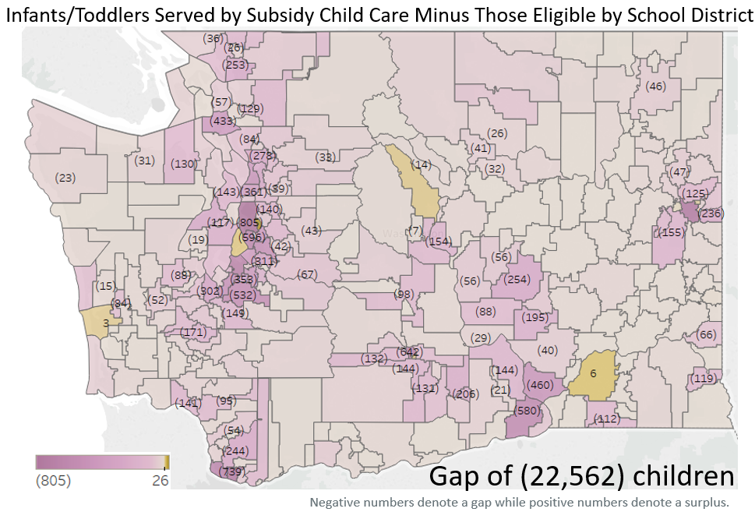
Gaps in Care, 2018
Infants/Toddlers
Subsidy Eligible
110%-185% FPL
Notes:
We’ve also been building capacity to identify gaps in care for young children on subsidy. This is an example of a map (by school districts) where we estimated the gap in the available care for infants/toddlers on subsidized care in families between 110-185% FPL.
We’re currently working on updating this information, but use it here as an example of the kind of capacity OIAa is developing to support our subsidy programs.

Slide 11
DCYF Priority Policy Work
1. Child Care Subsidy Program
CCSP Decision Package 2020
Subsidy Cliff
2. Access & Affordability
Partnership with Dept. of Commerce –
Child Care Collaborative Task Force
3. Integrated Preschool
Partnership with OSPI
ECEAP Rates assessment & 2022 entitlement

Slide 12
Thank you!
communications@dcyf.wa.gov

